Slide 1




Software Engineering
Lab Assignment 1
NGUYEN THANH DAT: 722I0004
TRAN THI THE NHAN: 523K0047

Slide 2
Table Of Contents
Requirement clarification
PART 01
Requirements Specification
PART 02
Diagrams visualizations
PART 03
UI Design & Demo Use Case
PART 04

Slide 3
PART 01: Requirement clarification
ID | Question | Clarified Answer
1 | Which transport modes does the kiosk cover at launch? | Bus and MRT at launch. Other modes (water bus, bicycles) are future options.
2 | Can a user buy multiple tickets in one transaction? | Yes. The user can select ticket quantity for group travel in a single payment.
3 | Is user login required? | No. Anonymous purchase by default. Optional “registered account” is future work.
4 | What payment methods are in scope? | Credit/debit card and QR e-wallets (MoMo, VNPay, ZaloPay). Cash is out of scope for this assignment.
5 | What happens if payment fails or is cancelled? | The transaction is cancelled, no ticket is printed, and the user returns to the main menu with a clear error message and retry option.
6 | How long is the QR code valid and what if it expires? | QR is valid for 60 seconds. If it expires, the user can generate a new QR or change payment method.
7 | What ticket format is issued? | A printed paper ticket with a QR barcode. The QR encodes ticket ID, origin, destination, fare, timestamp, and a simple checksum/signature.

Slide 4




ID | Question | Clarified Answer
8 | Is the ticket linked to a user profile? | No. Tickets are anonymous. If a logged-in option is added later, it remains optional.
9 | How are destinations shown? | All available destinations are listed. The kiosk highlights nearby or frequent destinations based on kiosk location.
10 | Which languages must the UI support? | Vietnamese and English at minimum. The app auto-starts in Vietnamese with a clear language toggle.
11 | What are the basic timing targets? | Max total purchase time: 2 minutes. Screen response within 300 ms. Card auth target < 5 s p95.
12 | Can users get a receipt? | Yes. A printed receipt on request. If the user enters a phone/email, an SMS/email receipt can be sent; otherwise skip.
13 | What if the printer jams or paper runs out? | The app pauses, shows a “printing issue” screen, and offers auto-reprint after staff resolves it. If printing cannot complete, payment is voided/refunded.
14 | Are refunds or cancellations allowed after payment? | Only if no ticket was printed or the ticket is unreadable. Otherwise, refunds are out of scope and handled by customer service.

Slide 5
PART 02: Requirements Specification
FUNCTIONAL REQUIREMENT
ID | Requirement Description
FR-01 | When the user presses Start, the system opens the Destination screen.
FR-02 | The system lets the user switch language (VN/EN) from any screen; default is Vietnamese.
FR-03 | The system lets the user choose a destination from a displayed list.
FR-04 | The system lets the user set ticket quantity (1–10) before payment.
FR-05 | After destination and quantity, the system shows the total fare and available payment methods.
FR-06 | The system offers exactly two payment methods: Credit/Debit Card and QR e-wallet (MoMo, VNPay, ZaloPay). Cash is out of scope.
FR-07 | If Card is chosen, the system prompts for insert/tap (EMV). No magstripe swipe.
FR-08 | The system sends an authorization request to the payment gateway and receives Approved/Declined/Timeout.
FR-09 | On card Approval, the system issues printed paper ticket(s) with QR barcode and shows a success screen.
FR-10 | If QR is chosen, the system displays a payment QR with amount and a visible 60-second countdown.
FR-11 | The system checks wallet payment status (paid/expired/cancelled). On expiry, user can generate a new QR or change method.

Slide 6
NON- FUNCTIONAL REQUIREMENT
ID | Requirement Description
NFR-01 | UI responsiveness: any screen change or control feedback ≤ 300 ms (p95). The Destination screen appears ≤ 2 s after Start.
NFR-02 | Fare quote time: showing total price after destination/quantity change ≤ 1 s (p95).
NFR-03 | QR flow latency: create order and display QR ≤ 2 s (p95).
NFR-04 | Card authorization round-trip ≤ 5 s (p95) and ≤ 10 s (p99). If >10 s, show progress with cancel option.
NFR-05 | From payment approval to print start ≤ 2 s; physical print completes ≤ 5 s per ticket (80×30 mm thermal).
NFR-06 | End-to-end purchase time target ≤ 120 s for a typical single ticket.
NFR-07 | Monthly availability ≥ 99.5% (error budget ≤ 3.6 h/month).
NFR-08 | Auto-recovery: on transient faults (network, gateway 5xx, device hiccup) the app retries with exponential backoff and returns to Ready state in ≤ 2 min without staff action.
NFR-09 | Power loss resilience: after restart ≤ 90 s to Ready; the last in-flight transaction is reconciled exactly once (no double charge, no lost ticket).
NFR-10 | Payment-path isolation: failure of one payment method (card or QR) does not disable the other; users can switch methods in the same session.
NFR-11 | Security: all external calls use TLS 1.2+; no PAN is stored; tokens only; kiosk is operated within PCI scope for the card path.
NFR-12 | Data integrity: each ticket has a unique ID and signed/checksummed payload; sales and payment records are written atomically and never partially stored.
NFR-13 | Logging/observability: structured logs for every step (selection, auth result, print result) with kiosk ID and timestamps; health heartbeat sent every 60 s; printer status and paper level exposed as metrics.
NFR-14 | Printer reliability: detect jam/out-of-paper; auto-reprint up to 2 times; unresolved print failures < 1 per 1,000 tickets and raise a service alert.
NFR-15 | Maintainability: fare tables and destination lists are reloadable at runtime without app restart; config change applies in ≤ 30 s.
NFR-16 | Degraded mode: if the payment gateway is unreachable for >30 s, show an “Out of service” screen and block new sessions while diagnostics remain available to staff.

Slide 7
DOMAIN REQUIREMENTS
ID | Requirement Description
DR-01 | Compliance: the kiosk must follow the operator’s rules for Bus/MRT ticketing and applicable payment regulations from the central bank and providers (card and e-wallet).
DR-02 | Fare policy: fares are loaded from an operator-supplied table or API. The MVP sells a Standard Adult Single-Ride ticket. Other products (child/senior/transfer/return) are enabled only if present in the fare data.
DR-03 | Origin binding: each kiosk is configured with a fixed origin station/stop code. Destinations and fares are computed from that origin.
DR-04 | Currency and rounding: VND only. Any rounding follows the operator’s fare table (e.g., to the nearest 1,000 VND if specified).
DR-05 | Ticket content: printed ticket must include unique Ticket ID, kiosk ID, origin, destination, fare, issue timestamp, validity window, and payment method.
DR-06 | Ticket barcode: the printed QR code must be readable by station validators and encode the ticket payload (at minimum Ticket ID, origin, destination, issue time, validity, checksum/signature).
DR-07 | QR standard: wallet QR must follow accepted specifications (EMVCo merchant-presented QR or the national scheme such as VietQR), as required by MoMo/VNPay/ZaloPay.
DR-08 | Validity rules: a single-ride ticket is valid for one entry within a configured time window (e.g., 60 minutes from issue). Exact window is configurable per operator policy.
DR-09 | Transfer/discount rules: if the operator provides transfer or discount entitlements, the system must apply them exactly as defined in the fare data and encode any entitlement in the ticket payload. If none are provided, no transfer/discount applies.
DR-10 | Refund/void policy: refunds at the kiosk are allowed only when payment succeeded but printing failed and no valid ticket was issued. All other refunds/exchanges are handled by customer service.
DR-11 | Receipts: printed receipts are available on request. Optional SMS/email receipts are sent only when the user provides contact details. No PII is stored beyond the receipt action.
DR-12 | Logging and retention: every transaction is logged with timestamps (Asia/Ho_Chi_Minh), kiosk ID, payment reference, and result. Logs are kept online ≥ 30 days and archived for up to 12 months. Clock is NTP-synchronized.

Slide 8
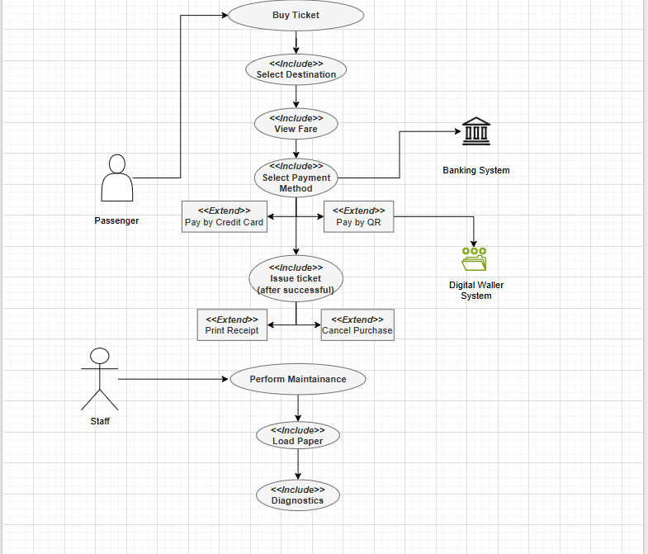
PART 03: Diagrams visualizations
Use Case modelling for Ticket Vendor Machine

Slide 9
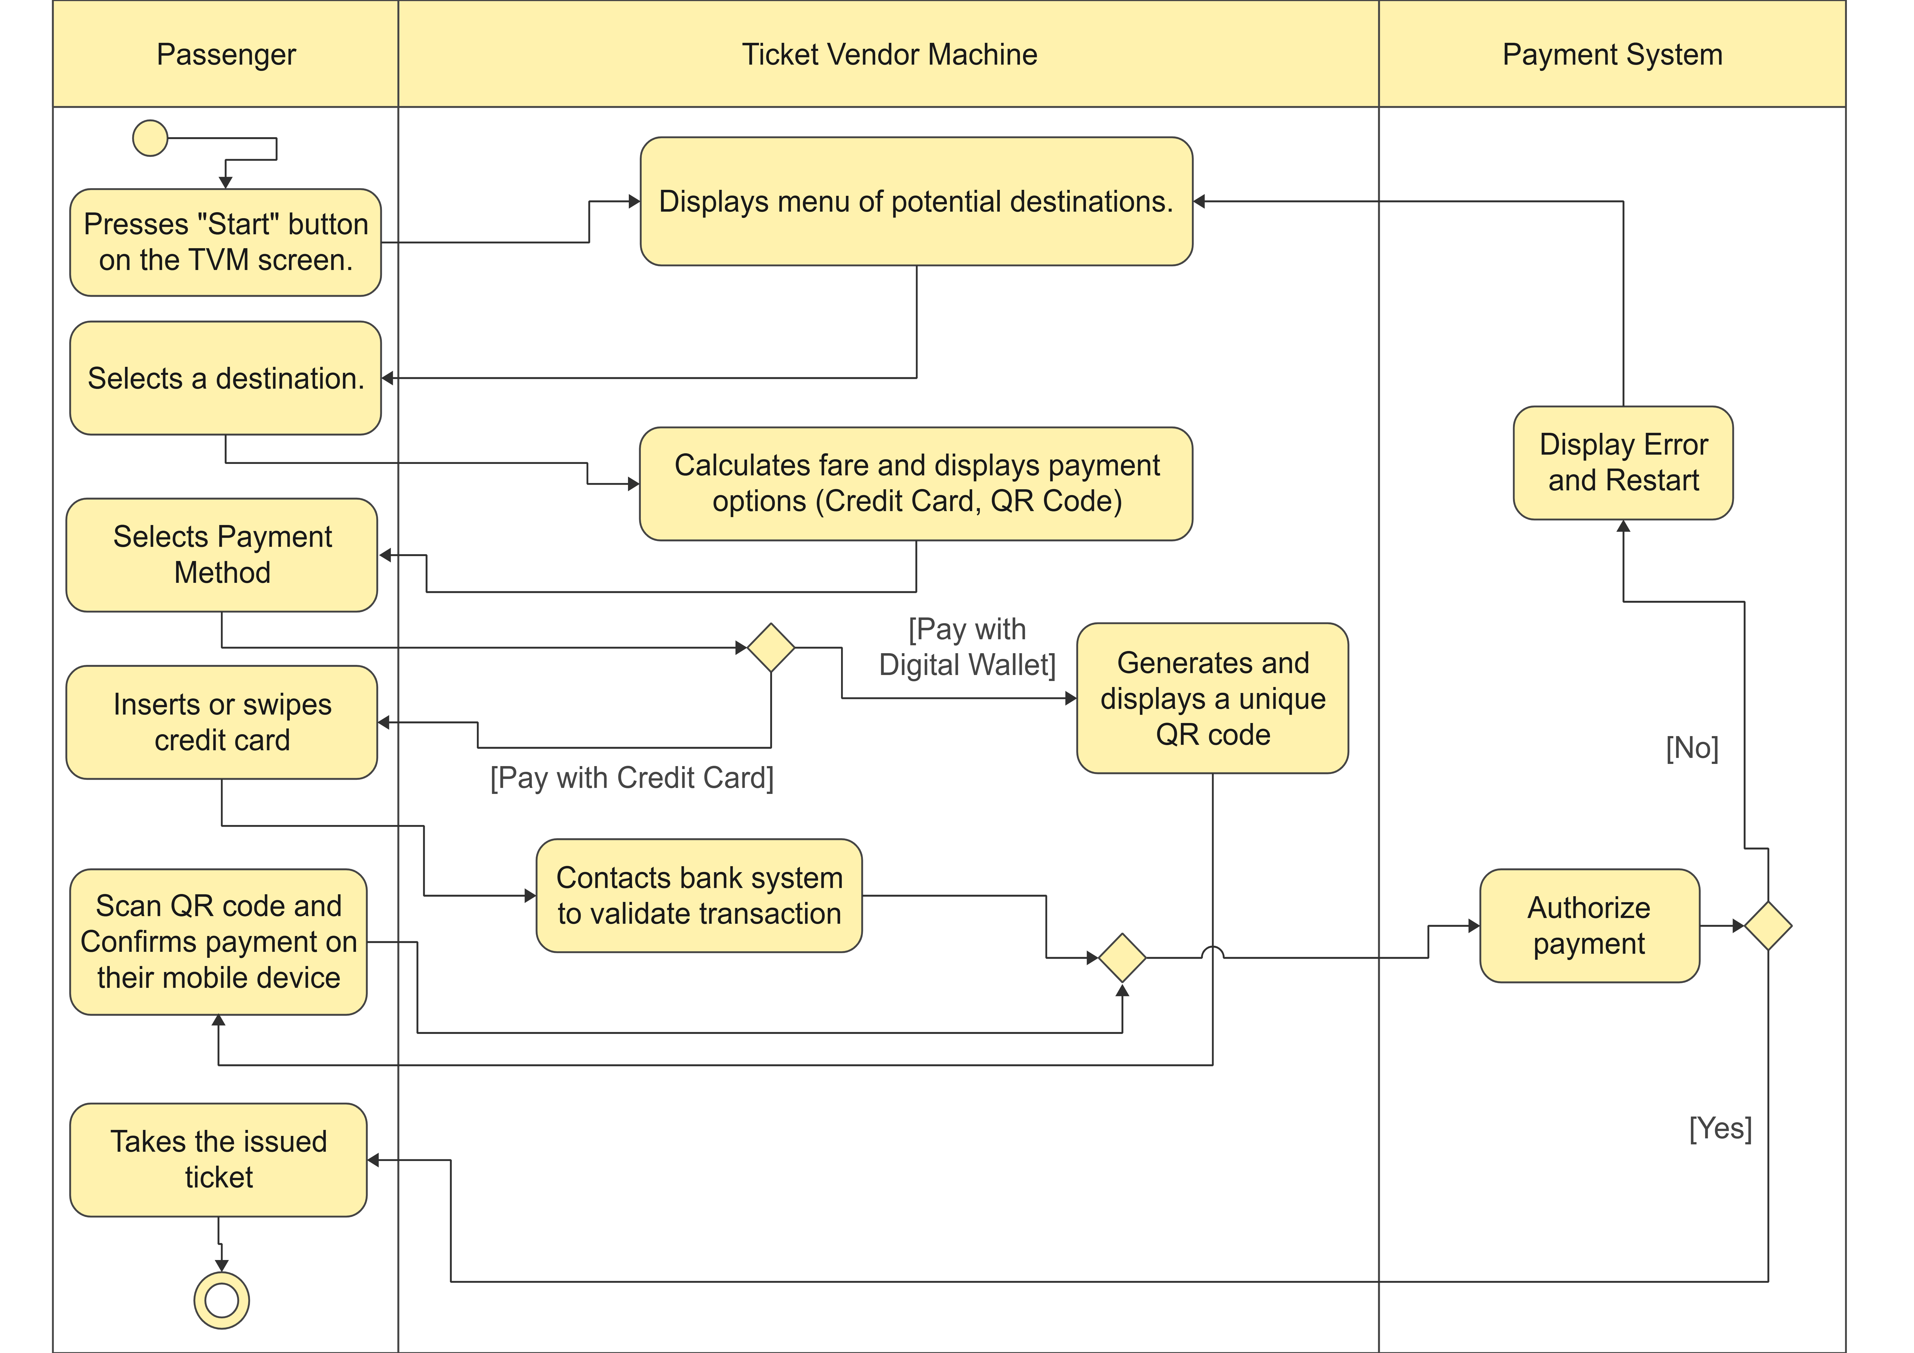
Activity Diagram Of Process Of Passenger’s Buying A Ticket From Ticket Vendor
Machine

Slide 10
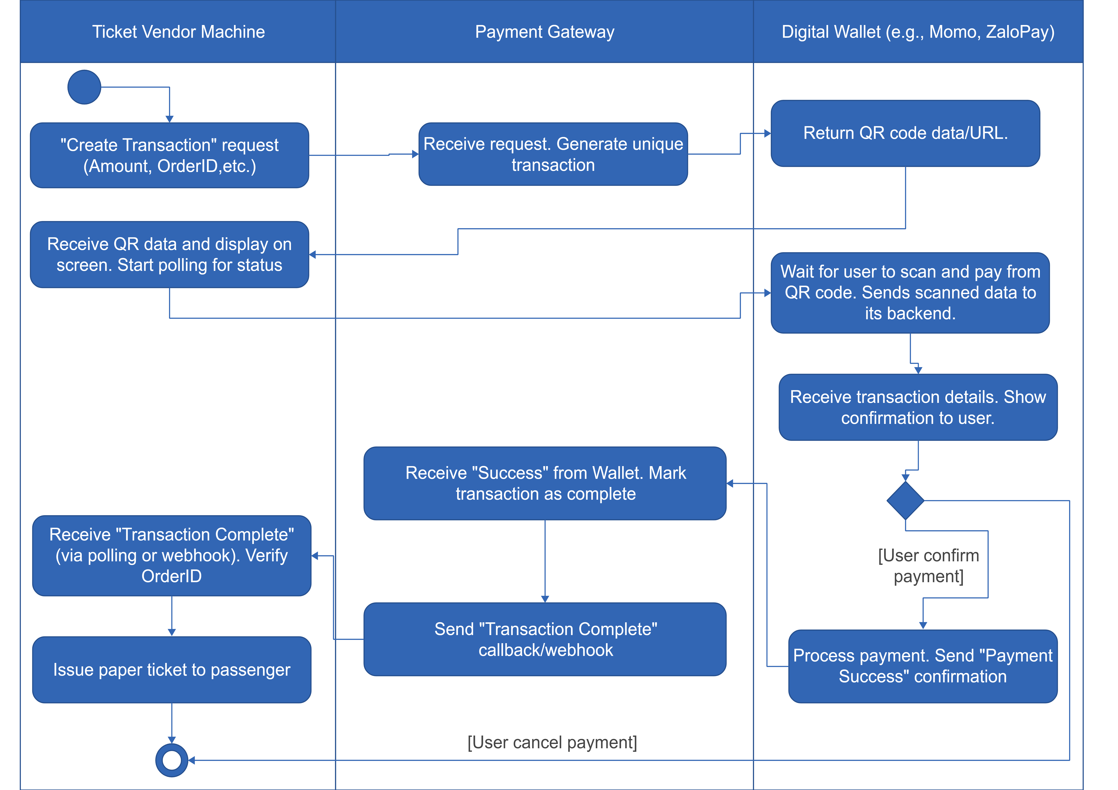
The Activity Diagram Inter-System Communication Of External Payment Systems

Slide 11
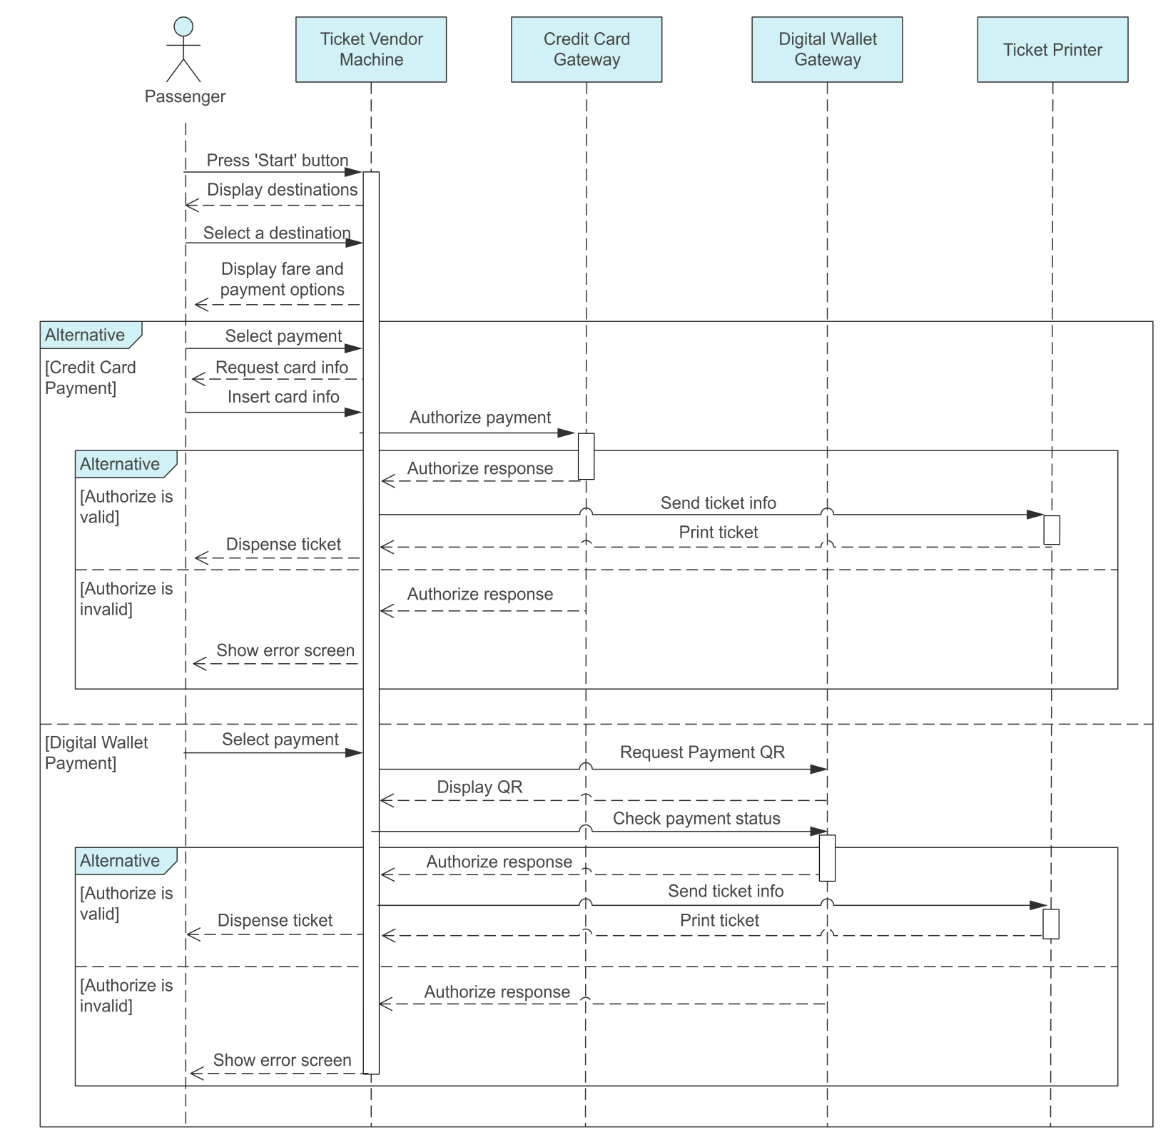
The Sequence Diagram Of The Ticketing Vendor Machine
(have main use case is buy a ticket)

Slide 12
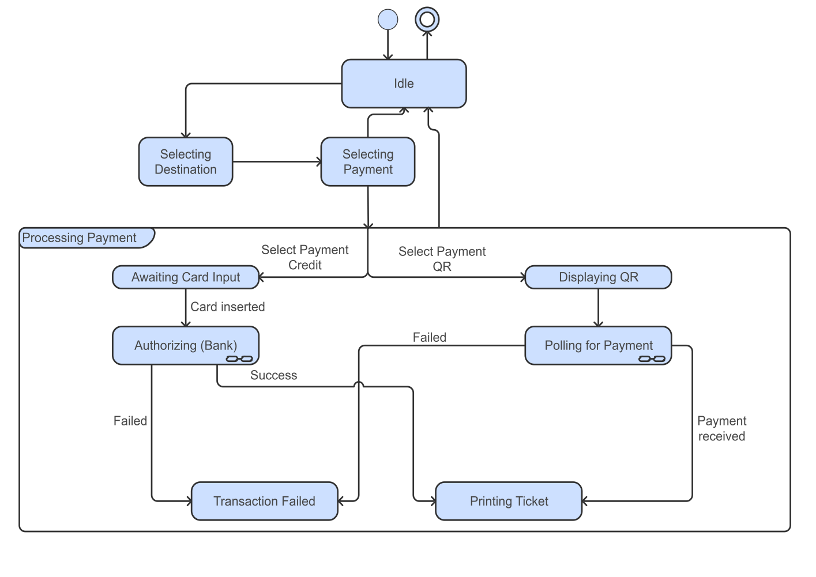
State chart diagram of the Ticketing Vendor Machine (have main use case is buy a ticket)

Slide 13
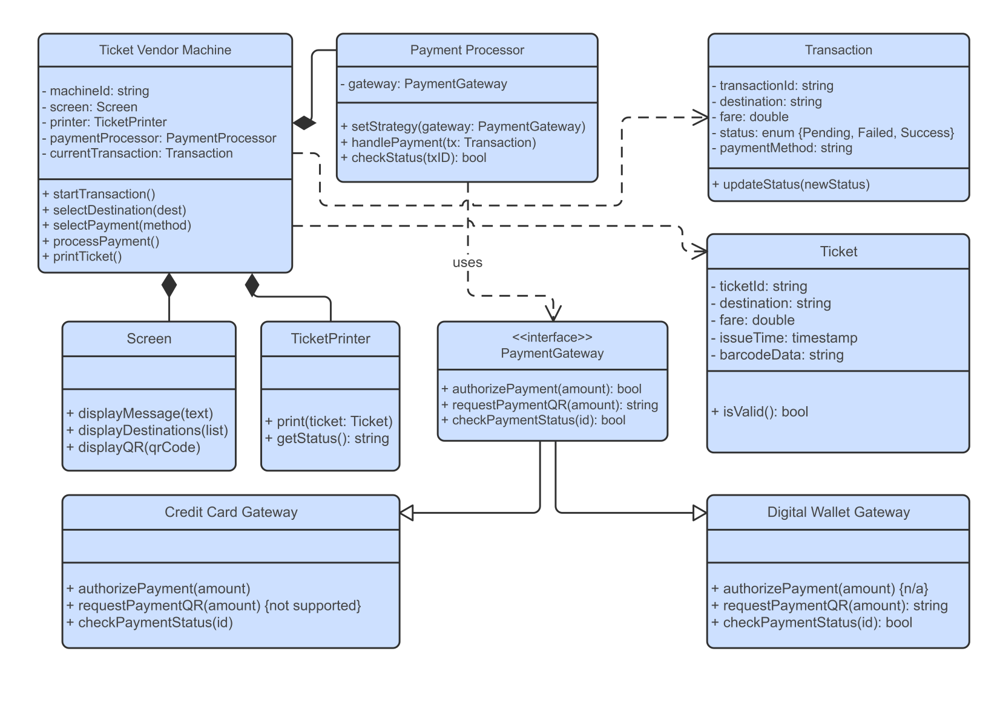
Class diagram of the Ticketing Vendor Machine
(have main use case is buy a ticket)

Slide 14
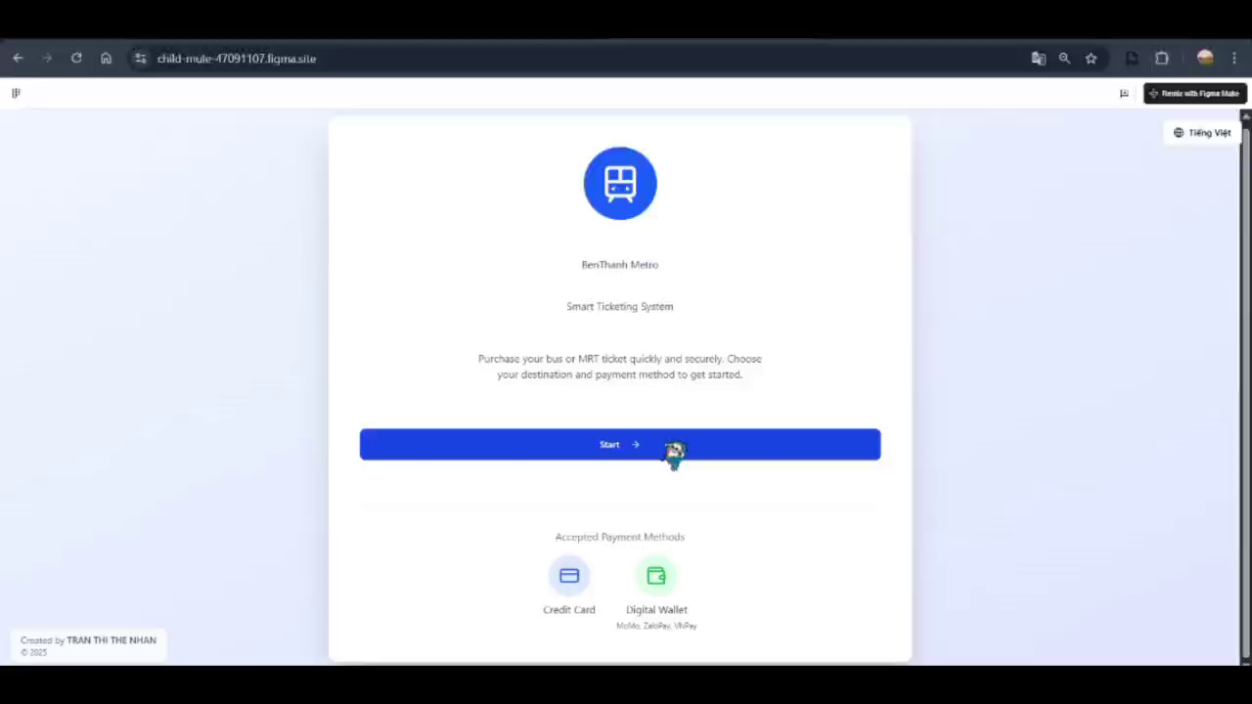
Prototype For Use Cases

Slide 15
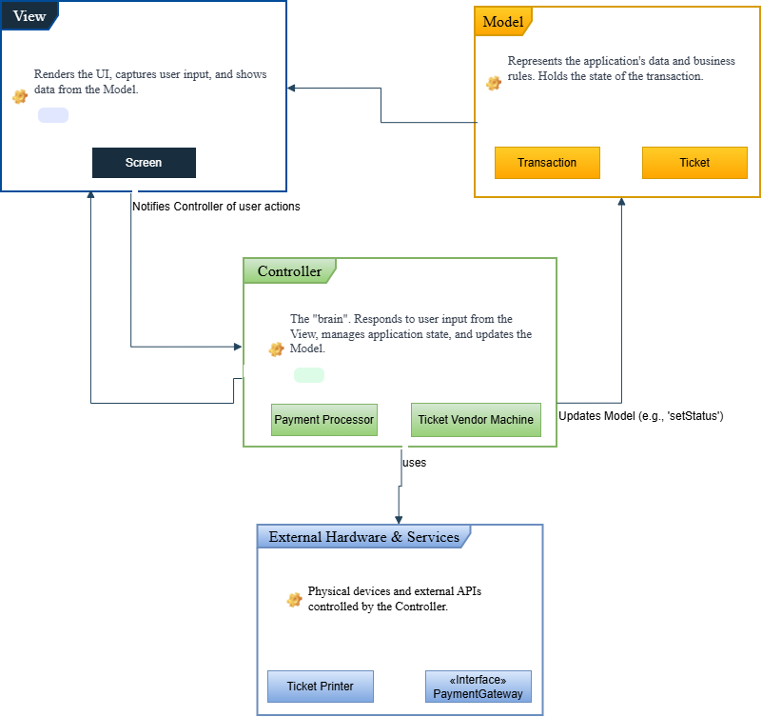
MVC Architecture Design of the Ticketing Vendor Machine

Slide 16
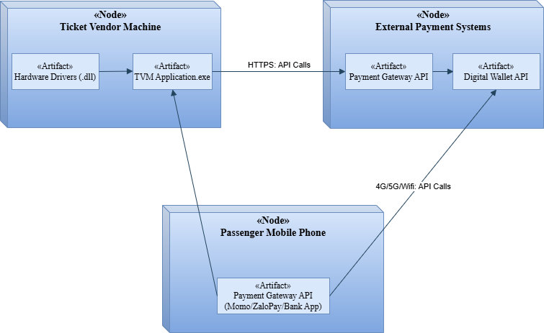
Deployment diagram of the Ticketing Vendor Machine

Slide 17
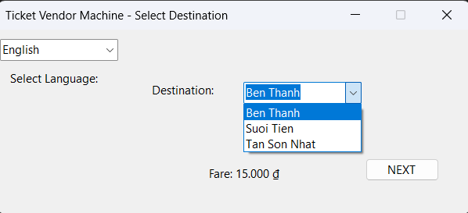
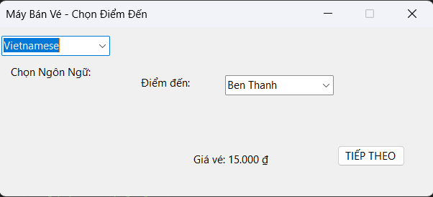
Demo Software
Home screen to select destinations with 2 languages version

Slide 18
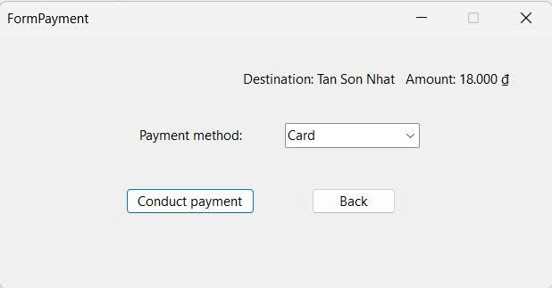
Demo Software
Payment Form to choose Payment Methods

Slide 19
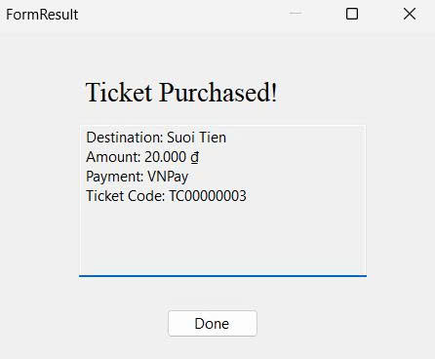
Demo Software
Payment Successfull Form

Slide 20
THANKS FOR LISTENING

